Slide 1
The Global Positioning System - GPS
“It’s Everywhere”
Prepared by
United States Coast Guard Auxiliary
Education Department
Notes:
This seminar course is designed for students desiring to learn fundamental GPS skills. Basic navigation skills are covered to the extent required to understand GPS operations. The course includes basic functions of the GPS chartplotter. Navigation computer software is not included in this course.
Required reading is GPS for Mariners (Second Edition), Chapters 1-4.
The textbook is used as reference material. The course doesn’t require pre- reading the book. The course outline introduces subjects sequentially, whereas the book introduces some subjects in groupings. The book chooses a more holistic presentation style, so it probably serves the student better to read it after the course lecture. The instructor uses the book at their discretion.
This course is designed for a minimum of two-2 hour sessions for a total of four hours. The four hour schedule requires a crisp fast presentation. Some instructors may choose longer class periods to cover the subjects in more detail. Longer class time may increase student tiring. Increasing the number of class days typically discourages enrollment. It is a local decision to choose the optimal class schedule.
A suggested breaking point for session 1 is slide #53
This is a seminar course with no final examination and no Certificate of Completion.
Note for those acquainted with GPS for Mariners - First Edition: The Second edition updates electronic navigation technology, it has more attractive color figures, and it devoted much more attention to navigation basics.
General Notes:
This course outline doesn’t follow the exact sequence of the book. The book accommodates readers who have varying levels of navigation skills; whereas, this class outline assumes that the student has very little prior knowledge of navigation.
The course includes chart plotting exercises using a very simple chart to avoid student intimidation. Using a local chart would be preferred; however, the flotilla would be required to re-create the exercises for their local charts.
It is preferred to use navigation tools for plotting, but the class exercises are designed to allow the use of plain paper as a ruler and for scaling functions.
This course outline assumes that the instructor has a good knowledge of GPS. This guide includes some of the main points to cover on each slide. The notes on the slide itself are often short cryptic statements for quick reminders.
Caution: The students will be plotting a simple course. The class schedule assumes that the student will perform this plotting quickly. It’s common for one or more students to require much assistance with plotting which consumes a lot of class time. The instructor must choose whether to add more class time to accommodate these students, or to offer counseling for the slower students after the class.

Slide 2
Auxiliary Disclaimer
Auxiliary Disclaimer
This United States Coast Guard Auxiliary course is intended to provide basic instruction about certain aspects of safe boating including discussion of safety items the law requires on recreational boats. This course is not a comprehensive program of instruction in seamanship or navigation and will not address all hazards and emergencies that may occur during recreational boating. Each boater is responsible to abide by the law and to act safely when boating. All boaters are encouraged to participate in more advanced boating courses available from the United States Coast Guard Auxiliary and other public and private entities.
2
Notes:
Auxiliary Disclaimer

Slide 3
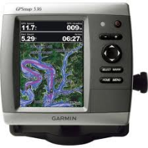
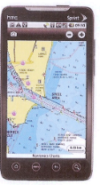
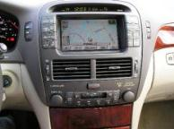
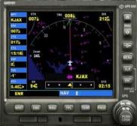
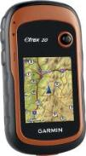
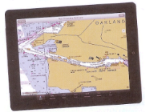
GPS Availability
Automobile
Marine
Cell Phones
Aircraft
Hiking
Tablets
3
Notes:
Ask how many students have a GPS in their car. Tell students that all recent cell phones have a GPS built in. Ask how many students have a tablet computer. Anyone with a aircraft GPS?
Students may be surprised to learn that they already have a GPS in something they own although the instructor will likely find that most students have some sort of automobile GPS.

Slide 4
What you will Learn
How the Global Positioning System (GPS) works
Marine Navigation
Types of GPS Receivers
How to navigate using a GPS
Waypoints
Routes
Following a course
Practical GPS Navigation Tips
Special features of GPS Chartplotters
Considerations for purchase
4
Notes:
Instructor Notes:
Now that the students are turned on to the course, tell them what will be covered in class. Keep the enthusiasm going!

Slide 5
Your Instructors
Lead instructor
Assistant instructor
Assistant instructor
Assistant instructor
5
Notes:
Introduce instructors at this point. Provide background as appropriate.

Slide 6
Housekeeping
Registration
Contact numbers
Facility Amenities'
Class Schedule
Topic Presentation
Tools
6
Notes:
Inform the students that this presentation doesn't follow the textbook’s presentation exactly.

Slide 7
Why Have a GPS On Your Boat?
Assist with navigation
Provide your position for help
7
Notes:
These are the most important reasons. Emphasize that a GPS assists the boater in getting from one point to another. It does not do 100% of the navigation job. It does not assure the boat will not encounter hazards. The operator has to take a lot of things into consideration to assure a successful trip. Some knowledge of basic navigation is needed to successfully use a GPS. Basis navigation will be covered in the course.
Emphasize that if all a boater uses a GPS for is to provide position information to authorities in case of a need for help, that alone is enough reason to have a GPS on-board.

Slide 8
How Does GPS Work?
Uses a network of orbiting satellites
Based on precise signal timing
8
Notes:
This is a setup for the next slide

Slide 9
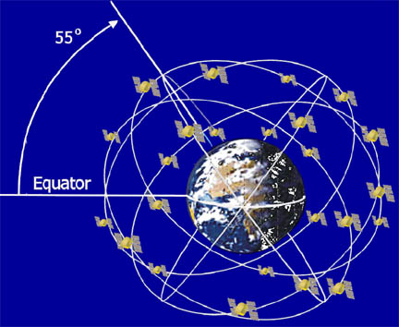
Satellite-Based System
9
Notes:
GPS is a satellite-based system. A constellation of satellites orbit the Earth. Each satellite completes an orbit every 12 hours. As a result they move across the sky slowly as viewed by an observer on the Earth. The constellation, of in-orbit satellites, provides a number of satellites in view at virtually every place on Earth. Three satellites must be in view at the same time to provide a position. There are typically 30 satellites in orbit of which 24 are active. The others are spares.

Slide 10
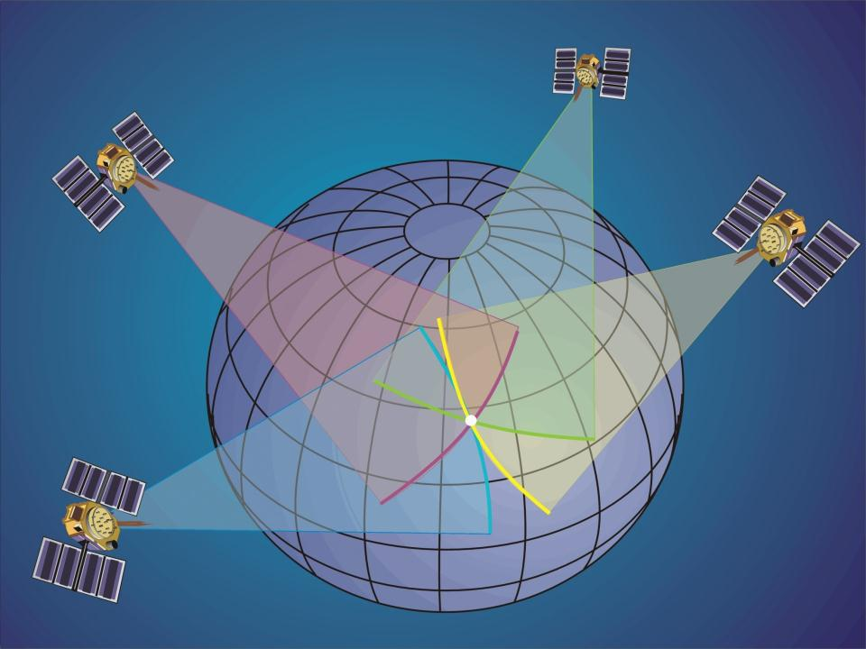
3-D Fix with 4 Satellites
10
Notes:
The entire mission of the satellites is to provide you with a position.
The satellite sends out a signal that includes its location along with the time the signal is sent.
The receiver has a clock that compares the time sent with the time received.
The receiver can figure out its distance from the satellite using knowing that radio waves travel at 186,000 miles per second!
Since the receiver was also given the satellites location, it can compute where the receiver is located in relation to the satellite.
This gives a circle on the earth where that same distance occurs; a circle of position.
Do this for more than two satellites and the receiver can give its owner a FIX.
There are two levels of fix that will provide you with a navigation solution, i.e., a position. A 2-D solution can be derived from at least three satellites. Three satellites provide three circles. Where all three coincide is the receiver's actual location on earth. The fourth satellite provides verification that one of the other three are not in error. This assumes that you are located on the surface of the Earth.
The more accurate position is the 3-D navigation solution that requires at least four satellites in view and providing signals to your GPS receiver. The forth satellite provides the elevation . The 3-D fix is generally accurate to about 30 feet along the surface of the Earth.

Slide 11
Satellite Selection is Automatic!
Best position & Best quality signal
4 satellites = high accuracy
3 satellites = degraded but operational
2 satellites = no position provided
11
Notes:
The GPS receiver selects the best satellites that are in view and that the operator does not have to make any of the selections.
The GPS receiver will actually calculate the accuracy of the fix based upon the specific satellite geometry of the satellites in-view. The receiver will display the calculated accuracy.

Slide 12
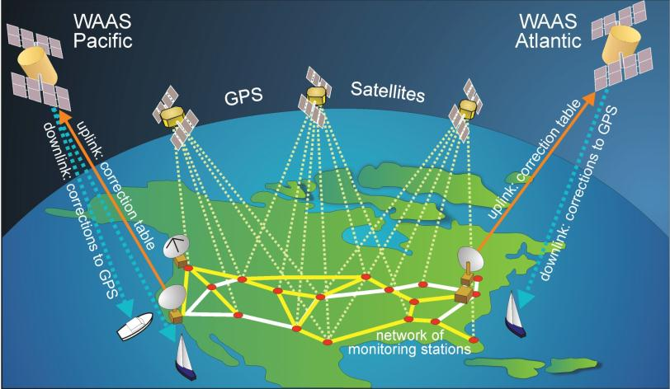
Wide Area Augmentation System (WAAS)
12
Notes:
Explain how it works. The WAAS satellites are geo-stationary (always at the same place in the sky). A GPS receiver at each ground station gives a position which the ground station compares to its known position (Geodetic marker). The ground station responds with the error in distance and direction. The WAAS system sends the correction to be applied to the user’s GPS. Thus, providing a more accurate position.

Slide 13
GPS Facts
Developed by the USAF
Became fully operational in the mid-90s
Worldwide Coverage
Accuracy w/o WAAS – 30’ or less
Accuracy with WAAS – 10’ or less
Poor penetration of buildings, boat cabins and foliage
13
Notes:
Emphasize that GPS is a worldwide system.
Incredible – a simple, inexpensive device that will give one’s location within 30 feet anywhere in the world. Also point out that much of this is American invention, engineering and investment!
Point out that if the GPS does not seem to be working correctly, it may not be receiving strong enough signals due to being inside a building, in dense foliage or perhaps inside of a boat with lots of obstructions overhead. Fortunately, newer GPS receivers are more sensitive than older devices so this is not usually a problem in a marine application. GPS can be jammed by hackers, but it’s rarely done.

Slide 14
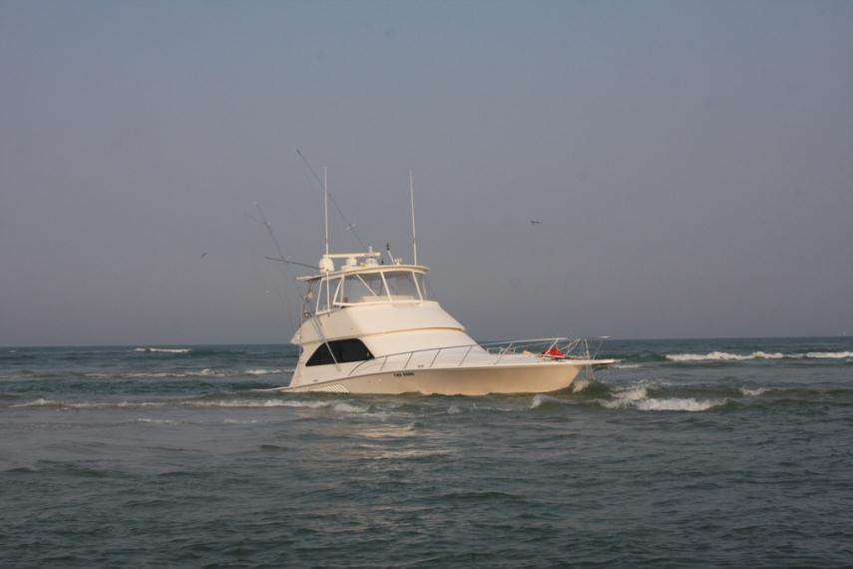
Good Reason To Know Navigation
14
Notes:
THIS IS A CLASS STIMULATOR OR MOTIVATOR. “This can happen to you if you lose track of where you are”

Slide 15
Why Learn Basic Navigation In A GPS Course?
GPS is an additional navigational aid
GPS uses navigation terminology
GPS may fail at a bad time
15
Notes:
Many people are intimidated with charts and avoid them. This slide must convince students it’s in their best interest to learn basic navigation/charting skills first

Slide 16
This Course covers only those navigation skills needed to effectively use a marine GPS
16
Notes:
Tell students about other textbook and courses that are available to learn more about marine navigation. Dutton’s, Chapman's, USCG Aux, USPS.

Slide 17
Chart Elements
Title Block
Projection
Scale
Latitude, Longitude & Distance
Horizontal Datum
Depth Soundings & Contour Lines
Compass Rose
17
Notes:
Describe each so that they will be anticipated later.

Slide 18
Title Block
18
Notes:
The Title Block is the focus for the discussion of charts, since most of the chart elements are listed here
Some of this information is needed to initially setup a GPS
Refer the students to page 17. This image was copied from the “Booklet Charts” provided in PDF at:
http://ocsdata.ncd.noaa.gov/BookletChart/
Address Chart Number and Edition. Current chart editions can be viewed at: http://www.nauticalcharts.noaa.gov/mcd/OnLineViewer.html

Slide 19
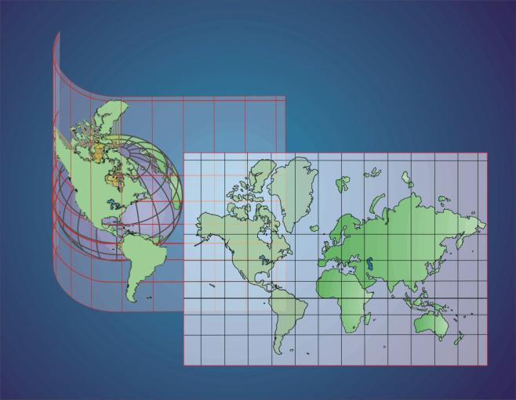
Projection
Mercator Projection
19
Notes:
Lines of longitude are projected parallel.to each other
Angles are correctly represented.
The farther from the equator, the greater the distortion. Other chart systems are used near the N/S poles
This probably the only chart projection you will use—except for perhaps River Charts

Slide 20
Chart Scale
Scale is the second Title Block entry, which is given for a specific Lat. Lat/Long.
20
Notes:
Scale is the second Title Block entry, which is given for a specific Lat. Lat/Long.
Discuss scale in general.
Quickly click through the scale slides to zoom out from:
Large scale = small area showing great detail
Small scale = large area for long distance planning

Slide 21
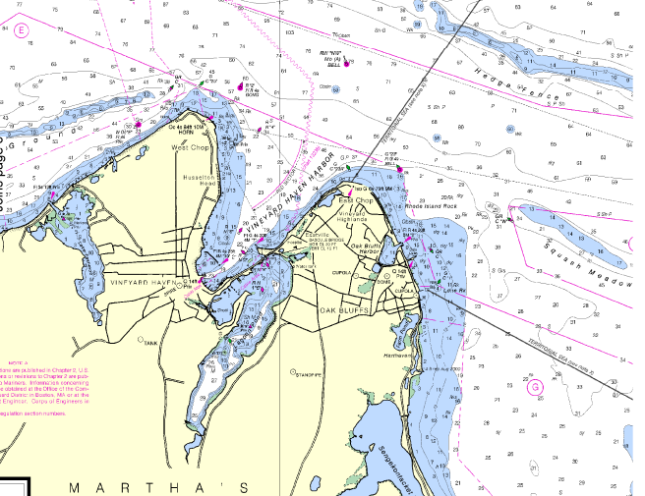
21
Notes:
This 1:10,000 chart provides a lot of local detail. 1:10,000 charts are sometimes called Harbor Charts. 1:10,000 means 1 inch, foot, mile and so forth on the chart is representing 10,000 as much distance on the earth.
Go through this slide and the next few rather quickly.

Slide 22
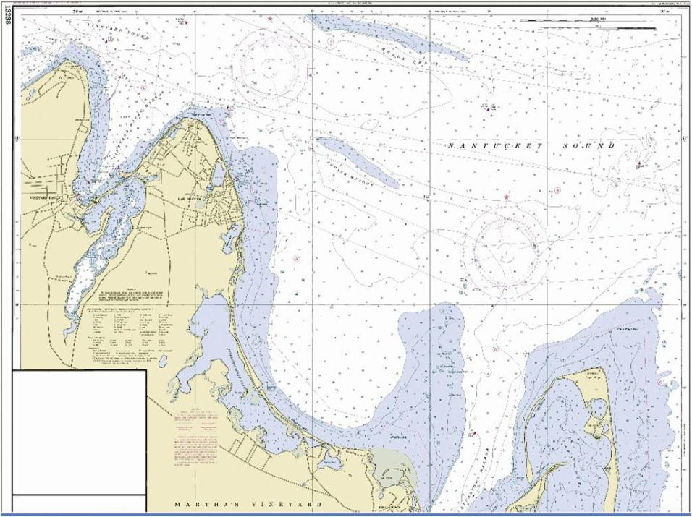
Scale 1:20,000
22
Notes:
The circle is that area that was shown on the first chart slide.

Slide 23
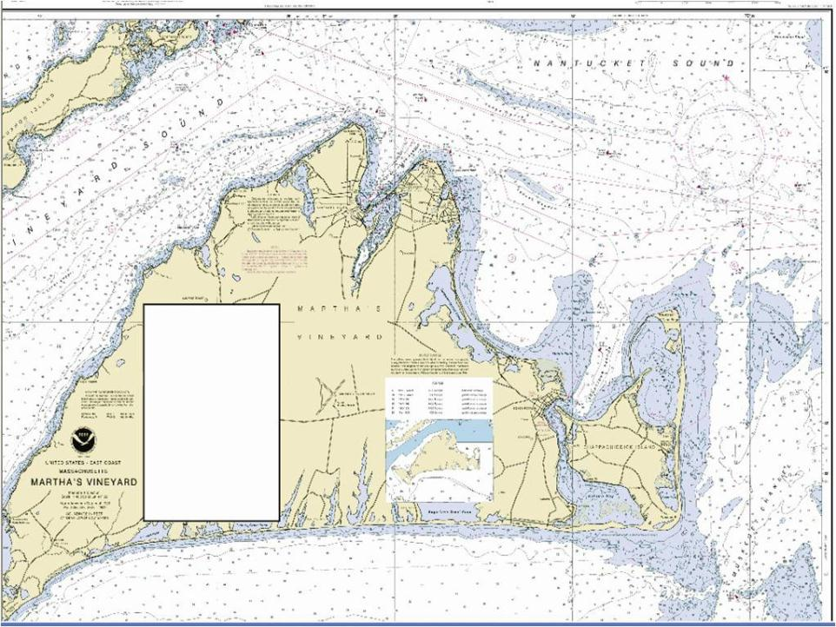
Scale 1:40,000
23
Notes:
The circled area gets smaller each time the scale is doubled. Zooming in with a magnifying glass will not give the level of detail that one can get from a smaller scale chart such as the 1:10,000 harbor chart.

Slide 24
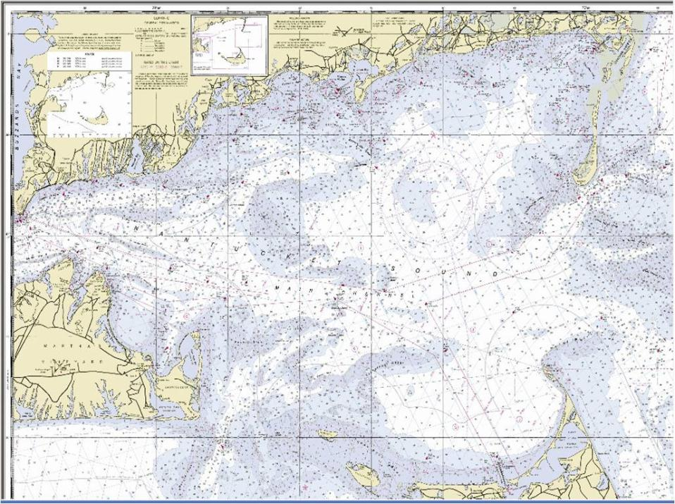
Scale 1:80,000
24

Slide 25
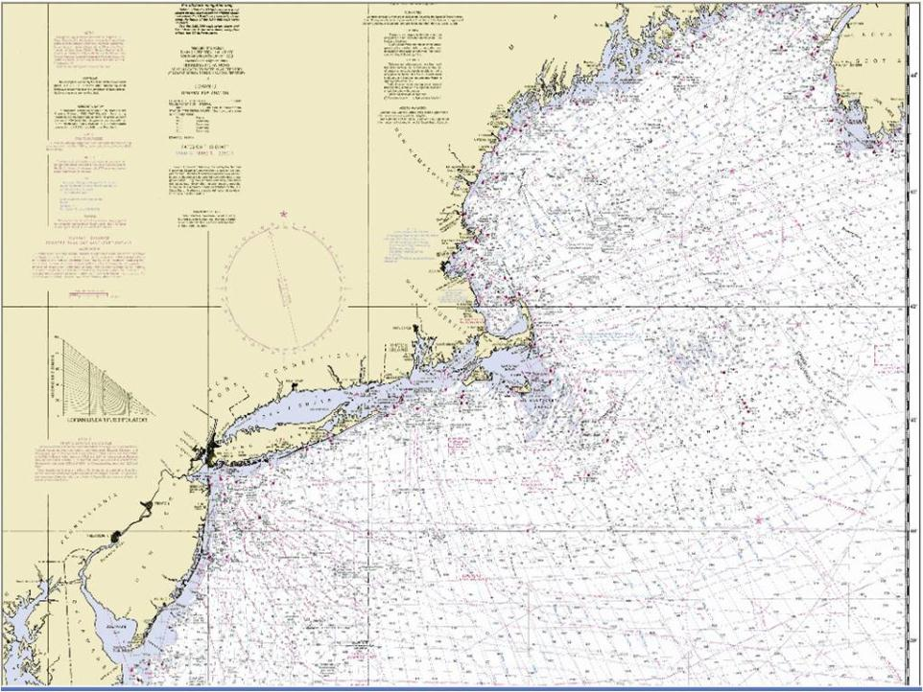
Scale 1:200,000
25

Slide 26
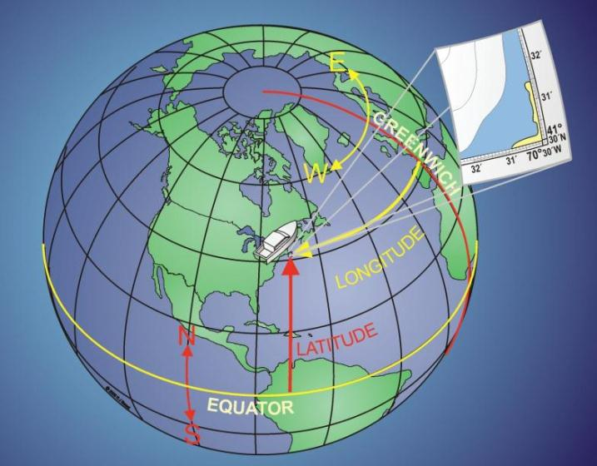
Latitude & Longitude
26
Notes:
General discussion. Class exercise is the next slide where the specifics of identifying Lat./Long. on a chart is demonstrated and practiced.
Meridians: 0° at Prime to 180°, E and W. 180° is the International Date Line!
Equator: 0° at Equator to 90°, N and S
1 Deg = 60 min, 1 min = 60 sec
Formats: Degrees° Minutes’ 10th of minutes / Degrees° Minutes’ Seconds”. Mariners use the minutes and fractional minutes.
A good time to introduce how the nautical mile is derived

Slide 27
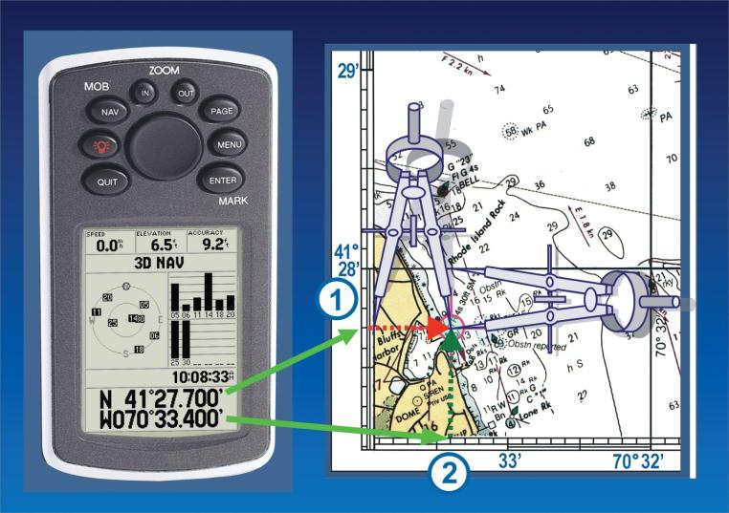
Dividers - Use
27
Notes:
Discuss using dividers and, when they are not available, use a sheet of paper or a ruler.
Some charts have the Lat./Long. scale is in minutes and seconds but most charts and marine navigation is degrees and minutes and fractional minutes.
One minute of latitude is one nautical mile = 6080 feet. One tenth of a minute of latitude is approximately 600 feet. One hundredth of a minute of latitude is 60 feet, and so forth.
The difference between 41 degrees 27.700 minutes of latitude and 41 degrees 27.701 is six feet!

Slide 28
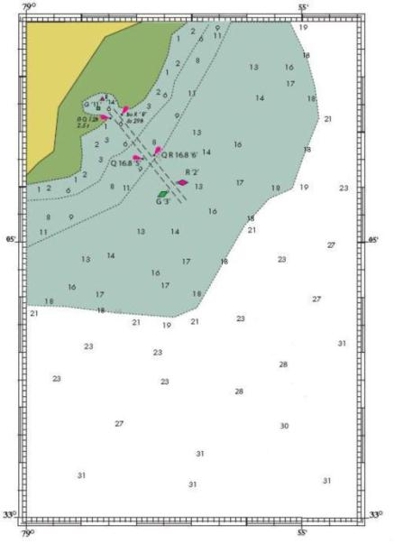
Practice Chart
Student Practice
Chart
28
Notes:
This is not a real chart. Chart provided by NOAA and modified by the USCG Auxiliary specifically for this course.
Hand out a paper copy of this chart to each student.
Describe what is on the chart; depths in feet, colors denoting minimum depths, buoys, day-marks, lighted aids, longitude and latitude scales.

Slide 29
Exercise
What’s the Latitude (Lat.) of the lower right corner?
33° 00.0’ N
What’s the Longitude (Long.) of the upper right corner?
078° 54.0’ W
What’s the Lat. and Long. of the left top corner?
33° 09.0’ N 079° 00.0’ W
29
Notes:
Use this exercise to discuss the specifics of reading Lat./Long. In degrees, minutes and 10ths of minutes.
For courses taught east of 100° longitude, get the students used to entering Longitude using a zero as the first digit. This is a good habit pattern for entering GPS waypoint coordinates.
TO REDUCE APPREHENSION ON CHARTS- Point out that this chart has most info removed to show that it isn’t that complicated if they learn one element of a chart at a time.

Slide 30
Exercise
What is the Lat./Long. of the green buoy, G “3”
33° 05.9’ N 078° 57.4’ W
What is the number located at: 33° 06.8’ N 078° 56.1’ W
“16”
30
Notes:
Traditional navigation measures to the nearest 0.1’, which is the practical limit of our charts, tools, and eyeballs.
Introduce the precision of GPS, which usually measures to the thousandth of a minute.
The GPS is more accurate than the charts and our ability to measure.

Slide 31
Measuring Distance
A distance scale will be found somewhere on a paper chart
31
Notes:
This is what a typical distance scale looks like.

Slide 32
Measuring Distance
One minute of Latitude is always one nautical mile
Longitude scale cannot be used to measure distance
32
Notes:
Explain why the longitude scale cannot be used to measure distance. The lines come together at the poles so the distance between longitude lines gets ever smaller as the poles are approached.

Slide 33
Exercise
Use a sheet of paper or dividers to measure
How far is it in nautical miles (nm) from bottom to top along the right side?
How far is it from marker G ‘3’ to marker G ‘11’?
9.0 nm
1.95 nm
33
Notes:
The traditional navigation standard of precision is to the nearest 0.1 nm. GPS receivers usually calculate distance to the hundredths of a nm.
A minute a mile.

Slide 34
Horizontal Datum
WGS84 - Datum
Benchmark for Lat. & Long.
North American Datum (NAD) 1983
World Geodetic System (WGS) 1984
Most US Charts used WGS 1984
Other parts of the world may use a different datum
34
Notes:
WGS84 is the datum of choice or most charts within the USA.
Why do you need to know this? Your GPS must be set to use the same datum as the charts you are using and the same datum others are using (rescue personnel for example).

Slide 35
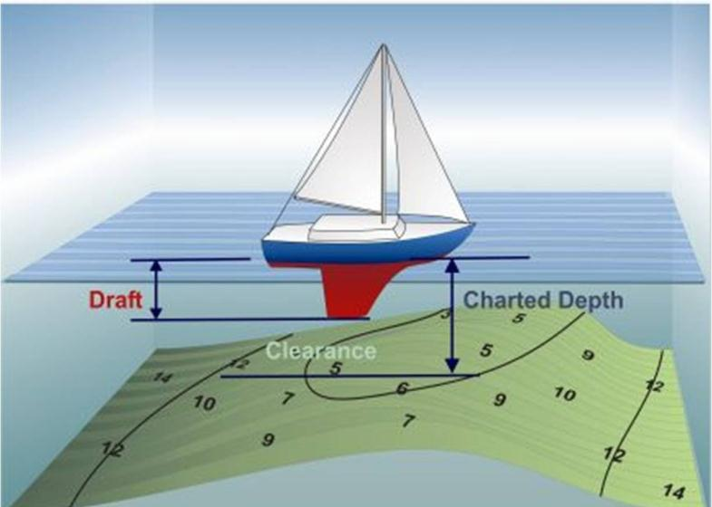
Contour lines
35
Notes:
Note the contour lines

Slide 36
Contour lines
What are the minimum and maximum depths within the white area of the chart?
What are the depths shown by the contour lines?
On charts, “shallow” areas are shaded blue. If you cruise into a shaded area on this chart, the charted depth will be . . .
18’ and 31’
18’, 11’, 6’
18 feet or less
36
Notes:
Discuss:
Explain contour lines. For example. In the white area, the depth is greater than or equal to 18 feet. In the adjacent blue area, the depth is 18 feet or less.
Datum at MLLW. There will probably be a difference between the charted soundings and what the depth actually is, because the chart is based on hydrographic surveys going a long way back, sometimes to pre-1900.
Source Diagrams
Effect of weather (winds, atmospheric pressure, rain, etc.)
Increments of 6’ are fathom contour lines.

Slide 37
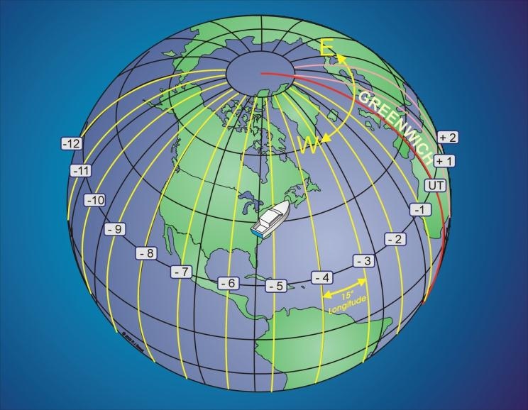
Time Reference On Earth
37
Notes:
This slide is used to introduce the concept of time zones and UTC in particular. Note that time zones are often not straight when they pass through land; for example, an island may choose to have one time zone and not two when a time meridian passes through the island.

Slide 38
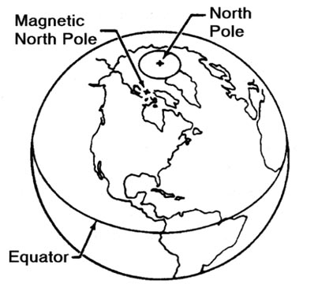
Relative Positions of Poles
T
M
x
Variation
38
Notes:
The magnetic pole is where a compass points. True north is where the constant longitude lines point.

Slide 39
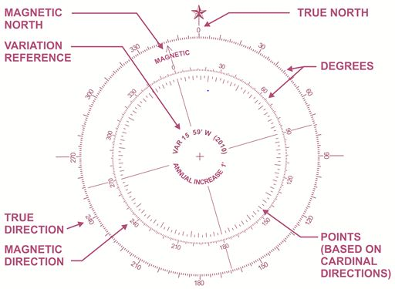
Compass Rose
39
Notes:
A compass rose is found on the chart, often in multiple places. It gives a reference to get a true course or a magnetic course. Lay a ruler between two points on the chart and then move the ruler to the compass rose without changing the ruler’s direction. Read off true or magnet course directly. A special type of instrument, called “Parallel Ruler” makes the job error-free. Other devices used also.
Go immediately to the next slide to show a parallel ruler.
Note that the magnetic variation changes slowly over time

Slide 40
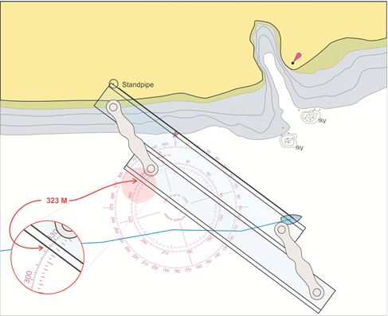
Parallel Ruler
40
Notes:
Explain how easy it is to get a magnetic bearing from the vessel to the standpipe by using the compass rose and a parallel ruler.
You will be using this parallel rule or something similar in the next task. A plain piece of paper may be used for an approximate measurement.

Slide 41
Let’s Take a Trip
A Trip is a Collection of “Waypoints”
Mariners Call the Planned Trip a “Route”
Select Waypoints and Layout the Route
Select Navigational Aids
Prequalify the Route for Hazards
Shoal Water
Horizontal Clearance
Clearance Overhead
Isolated Hazards
41
Notes:
Student knows that taking a trip over land requires constant changing on streets to get to destination. This compares to using waypoints and routes on the water.
Waypoints are like landmarks defining a street intersection or destination. A mariner may change direction and/or speed at a waypoint. Routes are collections of Waypoints going from departure to destination. For a trip of several days, the mariner will likely use multiple routes joined together

Slide 42
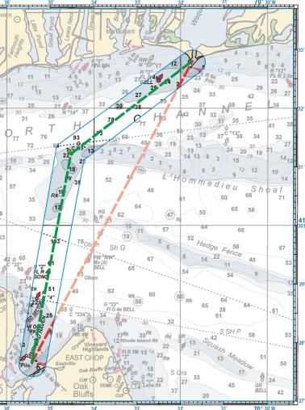
Laying out a Course
Going directly to the destination will not work because of shallow water
Must travel two legs to avoid the shallow water
42
Notes:
Space between waypoints called a “leg” Each leg is analyzed to assure there are no intervening hazards. Note that this journey was diverted to avoid a hazard.

Slide 43
Create a Route
Plot 33°05.9’ N and 078°57.4’ W which is where you leave the channel exiting your marina
Plot destination 33°0.8’ N and 78°59.0’ W which is your favorite fishing hole
Plot destination 33°06.8’ N and 78°54.5’ W which is another fishing hole
Return to R ‘2” at your marina’s entrance channel
43
Notes:
Create Route layout. If no tools are available, fold a piece of paper and plot each course as best you can. Determine distances using Latitude scale.
We shall soon see that a GPS can do much of this for the navigator! It is a great assistant.

Slide 44
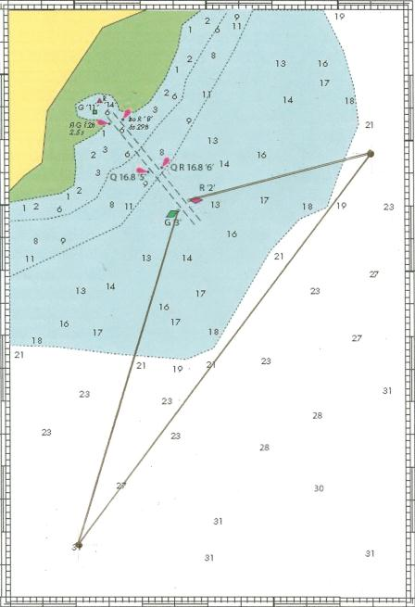
FH2
FH1
44
Notes:
Resulting route

Slide 45
Navigation Log
Waypoint | Course | Distance | Speed | Time | Time Actual
Home | Degrees | Nautical Miles | Knots | Hr : Min | Hr : Min
Fish hole 1 | 204 M | 5.4
Fish hole 2 | 043 M | 7.5
Home | 262 M | 2.82
45
Notes:
This is the result of the prior exercise put on a “Navigator’s Log” for the convenience of the helmsman. Helmsman may use the log and a compass to conduct the journey. The forerunner of a GPS route

Slide 46
How Long Will Each Leg Take?
60(minutes) x Distance(nm) = Speed(kn) x Time(minutes)
Distance = Speed x Time
60
Time = 60 x Distance
Speed
46
Notes:
Explain the formulas. GPS does this calculation for you.
Explain formula for TIME – SPEED –DISTANCE, and confirm the practice trip data on the Navigator’s Log. A GPS simplifies this greatly as it will determine much of this information. Navigators often use this formula in a quick mental “sanity check” to confirm that the GPS is working correctly. It should be memorized.
But we are not yet done planning. He Navigation Log must be modified so that we can use our compass to follow the intended course.

Slide 47
Navigation Log
Waypoint | Course | Distance | Speed | Time | Time Actual
Home | Degrees | Nautical Miles | Knots | Hr : Min | Hr : Min
Fish hole 1 | 204 M | 5.4 | 10.0 | 0:32
Fish hole 2 | 043 M | 7.5 | 10.0 | 0:45
Home | 262 M | 2.82 | 10.0 | 0:17
Time determined for an assumed boat speed of 10 knots
47
Notes:
All calculations shown on Navigators Log.

Slide 48
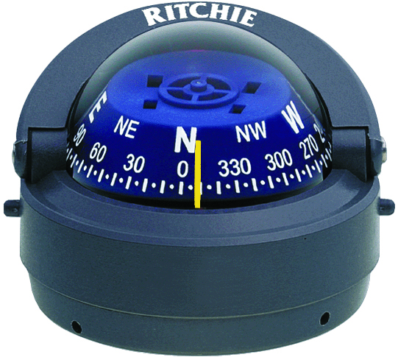
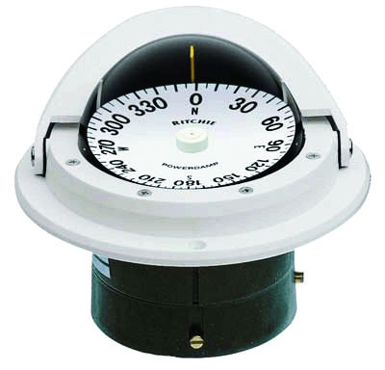
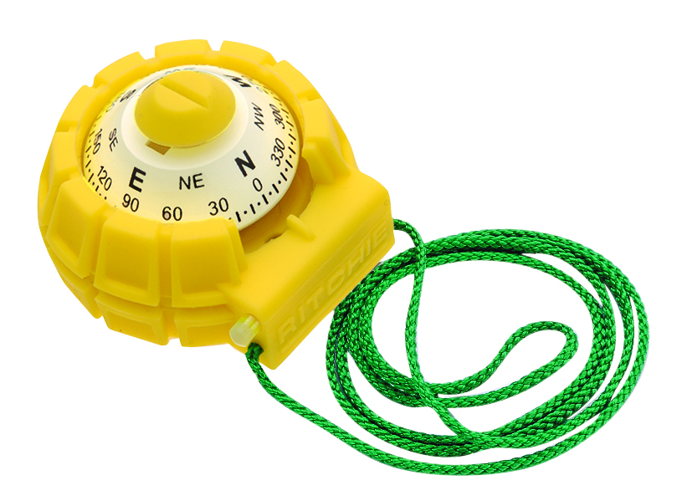
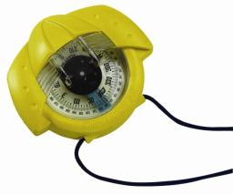
Magnetic Compass
48
Notes:
Discuss all compasses (front and back reading) and hand bearing compass as tools.

Slide 49
Compass Deviation
Deviation caused by magnetic stuff on the boat
Often caused by: speakers, fans, radios, anchors
Can be measured and compensated for fixed items
deviation values vary depending upon boats heading
Needed - a “Compass Deviation Table”
Don’t lay a handheld radio or cell phone near the compass
A GPS is not effected by Deviation
49
Notes:
A radio speaker 5 ft from compass can cause problems.
Orientation of this item changes the effective deviation.
EVERY BOAT SHOULD HAVE A COMPASS DEVIATION TABLE!

Slide 50
Correcting for Variation & Deviation
START
Tele-
T
True Bearing 005°
Vision
V
Variation 016° W
Makes
M
Magnetic Bearing 021°
DOWN
ADD
WEST
Dull
D
Deviation 003° E
Children
C
Compass Bearing 018°
East is Least and West is Best!
50
Notes:
Traditional navigation memory device, taken from the BS&S course, Chapter 9.
Can be Bearings, Headings, or Courses.

Slide 51
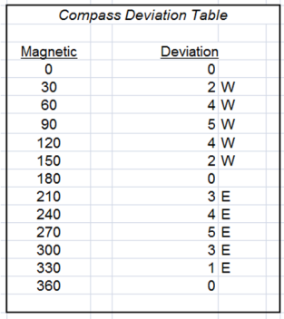
Navigation Log
Waypoint | Course | Distance | Speed | Time | Time Actual
Home | Degrees | Nautical Miles | Knots | Hr : Min | Hr : Min
Fish hole 1 | 204 M | 5.4 | 10.0 | 0:32
Fish hole 2 | 043 M | 7.5 | 10.0 | 0:45
Home | 262 M | 2.82 | 10.0 | 0:17
Before correcting for compass deviation
Waypoint | Course | Distance | Speed | Time | Time Actual
Home | Degrees | Nautical Miles | Knots | Hr : Min
Fish hole 1 | 201 C | 5.4 | 10.0 | 0:32
Fish hole 2 | 046 C | 7.5 | 10.0 | 0:45
Home | 257 C | 2.82 | 10.0 | 0:17
After correcting for compass deviation
51
Notes:
Navigators Log – before and after deviation.
Compass reading will be different than GPS –thinking that the GPS or compass is in error

Slide 52
Lines of Position and a Fix
At 2 pm (1400) a magnetic bearing is taken on the tank
1400 FIX
1400
260 M
Tank
1400
200 M
Then a magnetic bearing is taken on the tower
Tower
Where the two LOPs cross is a FIX
52
Notes:
Explain how to obtain a fix. We will see that a GPS constantly derives a fix.
A SUGGESTED BREAK POINT for SESSION 1

Slide 53
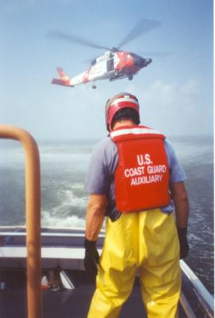
Marine GPS
Marine GPS
53
Notes:
Now that you have a knowledge of basic marine navigation, it is time to learn about how a marine GPS will make your navigation job much easier. It’s like having a dedicated navigator on your vessel. It can give you the situational awareness that greatly improves the safety of your vessel and crew as you go from your origination point to destination.

Slide 54
Types of Marine GPS Receivers
Handheld
Primary
Backup
Fixed Mount
Bracket mount
Permanent installation
54
Notes:
Many mariners use a handheld as their primary GPS, especially inland boaters. Some purchase a mount so it can be held in front of the helm station and can be plugged into ships power. Those with more expensive GPS installations often carry a handheld as a backup.
Fixed mount bracket mount GPS receivers have the advantage that the unit can be removed from the boat or put down below in locked storage for theft protection. Permanent installation is normally done by recessing the unit into a panel that is in front of the helm position.

Slide 55
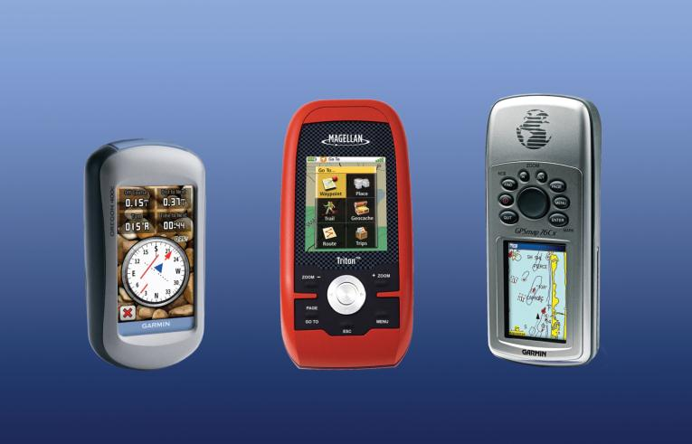
Handheld Marine GPS
55
Notes:
Here is an example of hand-held marine GPS units made by several different manufacturers. Some have push buttons to control operation. Most hand-held GPS units now have color displays with charting capability. Manufacturers still offer low-end black and white units with limited or no charting capability although these are becoming uncommon. Having a color charting capability adds greatly to situational awareness and thus contributes to safe operation of a vessel.
Most hand-held units are water resistant or waterproof. Many will float.
Prices range from just over $100 for a low-end B&W unit to almost $1000. Higher price is associated with a better display and an extensive built-in chart data base.
Some hand-held devices come with a basic color chart data base yet allow the buyer to add detailed charts for his or her area by the purchase of memory chips that plug into the side of the unit. Some manufacturers provide a USB connector whereby a cable can be connected to a computer to allow the downloading of additional charts into the unit’s memory.

Slide 56
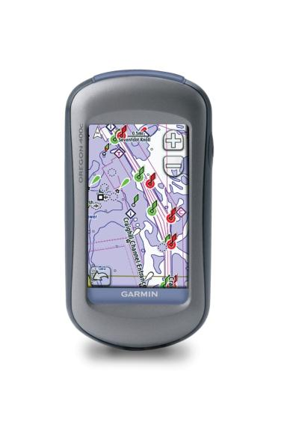
Handheld Marine GPS
With Touch-Screen
56
Notes:
Newer devices have touch screens and no physical buttons.

Slide 57
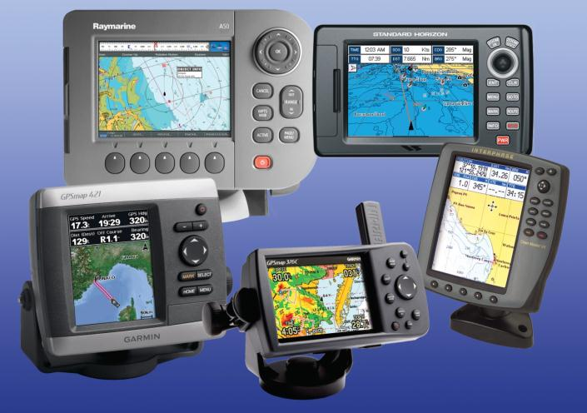
Fixed Mount Marine GPS
57
Notes:
Most fixed-mount marine GPS units sold today include impressive color charting capability. Higher-end units have charts that are identical in detail to paper charts. Prices range from $300 or so for a basic black and white chart plotter to many thousands of dollars for higher-end systems. The larger the display normally equates to higher-end.

Slide 58
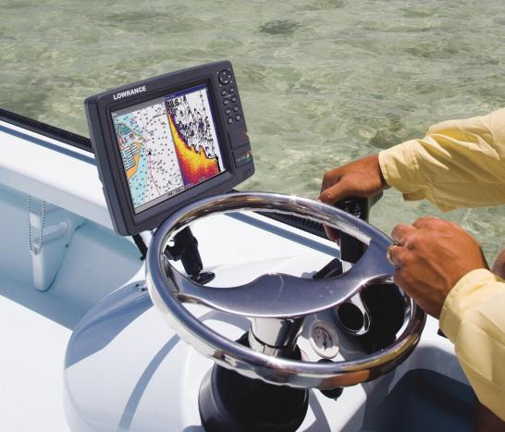
Typical Fixed-Mount Installation -removable-
58
Notes:
This slides shows a typical fixed-mount GPS mounted at the helm station of a smaller size boat.

Slide 59
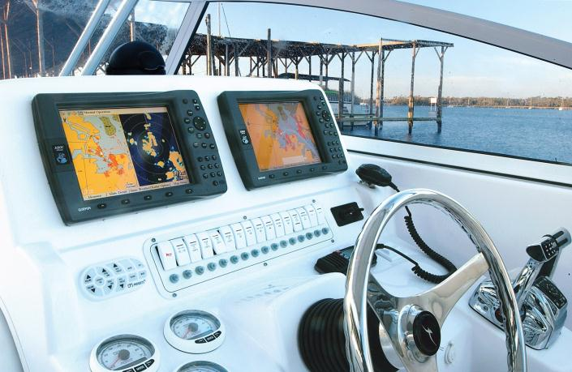
Typical Fixed Mount Installation -permanent-
59
Notes:
The Ray Marine system shown is integrated with a number of sensors contained within the boat. In addition to electronic charts, it is possible to show graphical display of water depth, undersea temperature profiles, view cameras mounted throughout the vessel, determine location and identification of nearby vessels and so forth.
Investment can go beyond $10,000 for a fully integrated system!

Slide 60
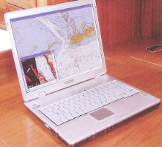
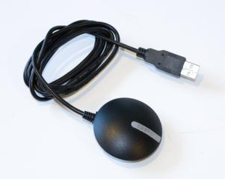
Computer Connected to a Basic GPS
Result – A Powerful Chartplotter!
60
Notes:
Some mariners purchase a low-end B&W GPS or a GPS brick (shown) that serves only to send longitude and latitude data to a desktop or laptop computer. Computer Assisted Navigation software and charts are purchased for the computer. The result is a powerful charting system. Such systems are usually restricted to vessels with an enclosed bridge where equipment can be protected from the elements and where the computer display can be kept out of direct sunlight.
Mariners have been using this combination of hardware for over 15 years with excellent results.

Slide 61
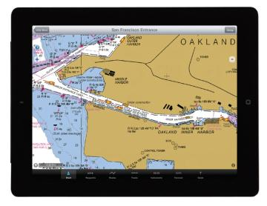
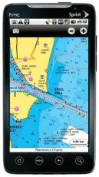
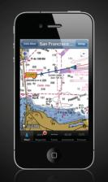
Non-Marine Specific GPS Devices -useful for marine navigation-
Tablet Computers
Smart Phones
61
Notes:
Tablet computers such as Apple’s I-pad and Android-based E-pads as well as smart phones are changing the landscape of marine navigation. In many cases, especially for inland river use, these devices may suffice to provide the needed situation awareness necessary for safe vessel operation. Navionic is one supplier of “Apps” for these devices. The Apps are very inexpensive. At the time this course was prepared, Navionics was selling their App, to include access to all USA and Canada charts for about $10! The Apps have limited navigational capability although it is very easy for a user to touch the screen to set-up waypoint and routes and accumulate a plotted track log. Look for more advancement in months and years to come.
At the time this course was developed, tablet computers and smart phones were not ruggedized for the marine environment (waterproof, sunlight visible displays), look for that to change in the months and years ahead.

Slide 62
How to Use a Marine GPS as a Navigational Tool
62
Notes:
With basic navigation now in-hand, let’s see how a GPS can simplify the navigator’s job!

Slide 63
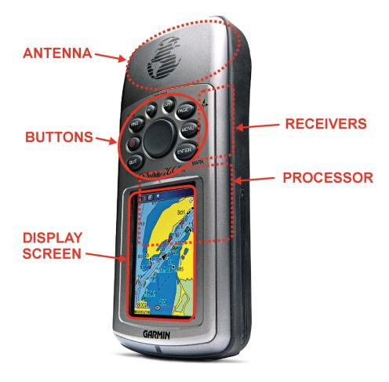
GPS Components
63
Notes:
Point out the major elements with special emphasis on the buttons, cursor and display screen. Point out that some newer GPS units are sold with touch screens, thus eliminating buttons. This lowers cost and may increase reliability. Touch screens also tend to be more user friendly.

Slide 64
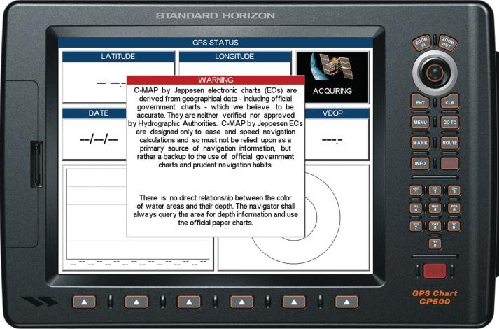
Power-Up
64
Notes:
Now, lets Power-Up a typical GPS and see what screens initially come up.
Upon power-up some devices have a disclaimer screen. It warns not to use the GPS as the principle navigational device. More about this later in the course.
Emphasize that one should never rely only on a GPS for navigation. Always check position by multiple means.

Slide 65
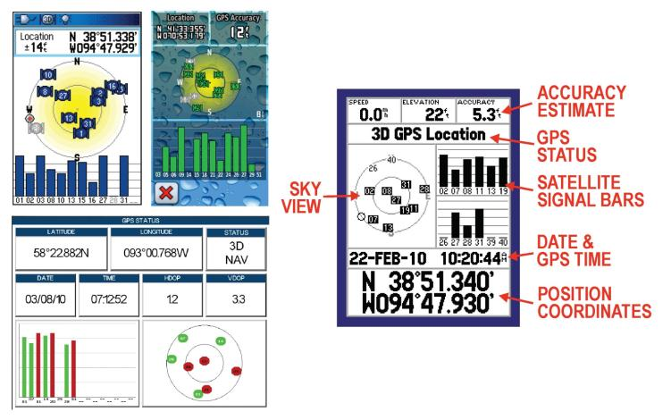
Satellite Acquisition Screen
65
Notes:
After the disclaimer screen, the next screen will be the satellite acquisition screen.
The screen usually is the first one to appear upon power-up as the user needs to confirm that the GPS has acquired a fix before proceeding to use it for navigation.
This screen in this slide shows the GPS locked-on the to satellite network and ready to navigate with a high degree of accuracy.
IN an emergency, this is the screen to go to in order to provide authorities with your location (longitude and latitude).
Briefly discuss why accuracy may vary. If WAAS is not turned on accuracy will suffer. If satellites are blocked from view such that only a small part of the sky is visible it may be difficult for the device to get an accurate fix. Anytime the user plans to rely on the GPS to provide very accurate positioning, he or she should check this screen to determine how accurate the GPS location is.

Slide 66
Time to Get an Accurate Fix
Cold Start
GPS moved significantly since last used
GPS not used for several months
Maybe 20 minutes to get a fix
Warm Start
Fix takes a matter of a few seconds
66
Notes:
A GPS just out of the box may take as much as 20 minutes to get the first fix, especially for devices manufactured a number of years ago. Newly manufactured devices are often able to do a cold-start fix in a matter of minutes.
Since the device was likely manufactured in Asia, if it is brand new, its last fix was likely half way around the globe!
Remind student they must use the satellite acquisition slide to ensure the GPS is ready for accurate navigation.

Slide 67
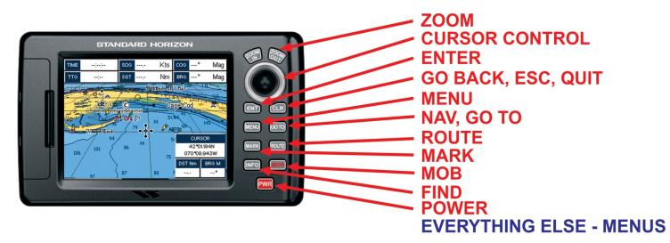
Buttons
67
Notes:
Discuss each of these buttons in detail. Explain what they do. See Sweet’s book for an excellent description of each function.
Point out that although each manufacturer may have a different layout or slightly different names for the button function, most units are very similar.

Slide 68
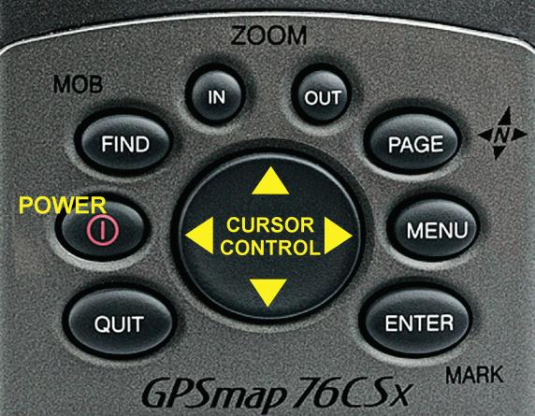
Buttons
68
Notes:
This display is for the Garmin handheld GPSmap 76CSx. Note that the buttons are almost identical to those discussed on the previous slide.
This is a good slide to use to explain what the cursor is used for. It allows one to scroll around the map display. it is used to enter names and values for waypoints, and it is used to move up, down and around menus. It is an important button!

Slide 69
GPS Screens
Notes:
There are many more types of screens that can be selected to view.

Slide 70
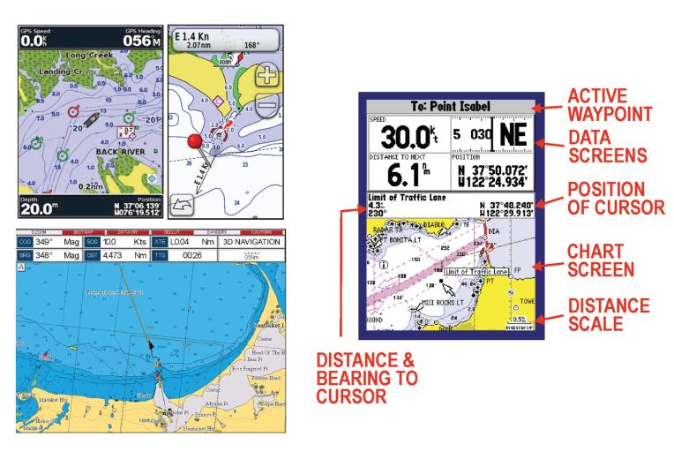
Chart Screen
70
Notes:
Explain that one must have an active waypoint entered in order for the GPS to calculate some of the data shown.
These are chart screens from four different GPS devices.

Slide 71
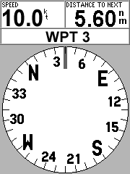
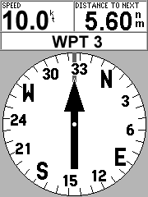
Compass Screen
Vessel’s heading
Pointing to active waypoint
Headed to active waypoint
Only accurate if you’re moving
71
Notes:
Discuss.
Note that if the vessel is not moving then the GPS is not able to provide an accurate compass heading unless the device has a built-in magnetic sensor. Some newer GPS units have a built-in magnetic sensor.
Explain that the GPS computer calculates course, speed, time-in-route, estimate time of arrival and so forth from examining changes in longitude and latitude.

Slide 72
Highway screen
72
Notes:
This screen also requires an active waypoint. As long as the vessel is kept in the middle of the road it will reach to selected waypoint while staying on the desired straight-line course. If additional waypoints have been entered and identified as a route, then those waypoint will show further down the road and the direction of the road will change as each waypoint is reached.
This is a very useful screen for staying on course. Deviation from desired course is immediately apparent as well as the required corrective action to get back on course.
Three different GPS devices are represented in the slide. Note the screen in the upper-left; it shows cross-track error. Usually, the data shown on the Highway screen can be selected by the user during Setup.

Slide 73
Highway screen
On-Course
Off-Course
Heading Off-Course
73
Notes:
Explain each situation. The highway picture makes it obvious when the vessel is on-course, off-course or about to head off-course. A quick glance at the highway screen is all it takes to assess the situation. That is one advantage of this screen.

Slide 74
Trip Computer Screen
74
Notes:
During setup, a user can define exactly what parameters he or she want on this display. For example, the user may prefer the data field that is showing altitude to show something else that is more valuable to the mariner!

Slide 75
Tide Screen
75
Notes:
Some GPS units also have tide and current tables in their internal database.

Slide 76
Examples of Menu Screens
76
Notes:
Discuss that the single display allows one to see many different sets of data.
The Menu screen is an important one. Some GPS units have a dedicated push button to get to the Menu screen.
Shown are menu screens for several different types of GPS devices. The top screen is associated with a touch-screen GPS. For the other two screens, the cursor control is used for menu selection.

Slide 77
Menu Screen Selections
Setup
Time
Coordinate Format
Horizontal Datum (e.g. WGS-84)
Units of Measure (nautical, statute, metric)
Direction (true or magnetic)
Communication (e.g. NMEA 0183)
WAAS Enable
Navigation or Simulation Mode
77
Notes:
The Menu screen is an important one. Typical choices include Setup, Navigation, Locate and Screens.
Upon first use, it is important to go to the Setup menu and establish the required parameters of use.
Describe what each of the Setup choices do.
Discuss Simulation mode and the advantages of using it. One can practice in the comfort of one’s home without the need to have GPS satellite-lock.
If one uses the simulator mode it is imperative that they switch back to navigation mode before using the GPS for actual navigation.

Slide 78
Menu Screen Selections
Navigation
Waypoints
Marks
Routes
Locate
Find navigation points
Find charted data
Screens
Data Fields
Orientation (north-up, course-up)
Color palette (day, night)
78
Notes:
The Navigation menu is a very important one. This is where waypoints and routes are entered and managed.
Discuss the remainder of the menu list.

Slide 79
GPS Waypoint Navigation
How to enter a waypoint
How to “go-to” a waypoint
79
Notes:
Now we will learn how to use the GPS for navigation.

Slide 80
Waypoint
Waypoints define a position on the water – for any purpose
Waypoint consists of:
Name
Latitude
Longitude
Waypoints may be pre-installed or entered by the user
80
Notes:
Remind students what a waypoint is. We first discussed waypoints during the charting exercises.
Devices with charting capability will have lots of pre-entered waypoints representing aids to navigation (buoys, fixed aids, etc.).

Slide 81
Waypoint Entry Methods
Mark
Select from an internal list
Point – touch screen on a chart
Cursor – on a chart
Download from a Computer
Direct entry of name, latitude & longitude
81
Notes:
Lower-end GPS devices will have a more limited set of entry methods that high-end units with chart plotting capability.
Some mariners use computer assisted mapping systems to define waypoints which they then download to a portable GPS. They take the portable GPS to the boat with needed waypoints already entered.
Only the last method, direct entry, requires longitude and latitude values to be provided by the user. It is the only method that requires the used of a paper chart and plotting tools and skills!

Slide 82
Mark your Waypoint
Press the “Mark” button
Brings up Waypoint Screen
82
Notes:
To MARK the Waypoint on the water, press the MARK button (on some models, this is the same as the ENTER button as shown).
This brings up the New Waypoint Screen as shown with a number assigned and the coordinates already entered.
To accept this, simply press ENTER.
This is a very easy way to enter waypoints for future use when out on the water is good weather.
If someone falls overboard, hitting the Mark key immediately records the position of the MOB which can then be used to navigate back to the person. Some GPS devices have a separate MOB key that is used specifically for man overboard; it immediately brings the device into the navigation mode to the MOB waypoint.

Slide 83
Waypoints From An Internal List
83
Notes:
Describe the process of selecting waypoints from an internal list.

Slide 84
Touch Screen Entry
84
Notes:
Units with touch-screen capability are very easy to use to define waypoints. Just touch where you want a waypoint. It is easy to see from the chart where navigatable waters are and thus where to locate a waypoint.
In the photo above you can see that a route is being defined. A route is a collection of sequential waypoints. We will discuss routes in more detail in a few minutes.
Note that this navigator has chosen waypoints near the green buoys but not directly at the buoys. In bad weather you would like to have waypoints near navigation aids but not directly at the aid. In very poor visibility, selection of the actual aid as a waypoint may result in a collision! That is how accurate GPS is!

Slide 85
Cursor Method
Use the cursor key
Scroll to specific coordinates
To a course & distance or
Scroll to object on screen (if any)
Tip of arrow shows scroll position
Current position
85
Notes:
Input option – Scroll the cursor on the Map Screen.
On most GPS models, the coordinates of the Cursor position are displayed on the screen.
Scroll until the desired coordinates or desired Navigation aid is highlighted.
Mark this location as a waypoint.

Slide 86
Download from a Computer
86
Notes:
Some mariners use computer assisted mapping systems to define waypoints which they then download to a portable GPS. They take the portable GPS to the boat with needed waypoints already entered.

Slide 87
Direct Data Entry
Scroll down to select field
Press “enter”, scroll right to select character field, scroll up/down to select character, press “enter” when finished
Scroll down to select “done”, press “enter”
87
Notes:
Waypoint Coordinates might be entered as follows:
Take student through the process. Point out each GPS is a little different. Read your GPS manual for the correct method for your set and practice, practice, practice before depending upon your GPS on-the-water.

Slide 88
Be Careful!
Latitude and Longitude are just numbers
Be very careful when entering waypoints, or transferring position to a chart
Number errors are common; especially transpositions
Using an aid to navigation as a waypoint has a risk
In poor visibility, you may hit the aid!
88
Notes:
Entering a number with one digit in error can result in a serious navigational mistake. It is not the big errors that will get you. They tend to be obvious (1000 miles to go to the next waypoint)! The smaller errors of a few hundred feet can put you outside the channel and up on the rocks! That is why the higher-end GPS units have real value. With a color chart plotter it is often obvious when waypoint entries are incorrect because it is easy to see that the waypoint is out of the channel. One avoided grounding will easily pay for a more expensive GPS that has color chart plotting capability.
Using an Aid to Navigation may result in a collision. Select a waypoint nearby the aid.

Slide 89
Adding Waypoint Information
89
Notes:
Different GPS devices provide different ways to annotate waypoint information. For some devices, only the name can be changed. For others, it is possible to select unique symbols for the specific waypoint when it is displayed on the map screen as well as to enter descriptive text. Even a keyboard might be provided to make it easier to enter the text and numerical values.
Higher-end units tend to be more user-friendly!

Slide 90
Go To a Waypoint
Select the Waypoint
Select “Go To”
Select a Navigation Screen
90
Notes:
Now lets discuss how to navigate to a waypoint.
Use the navigation screen that works best for you. Many people like the highway screen as it is obvious when you get off course. Others much prefer to show a chart so that they can see what is around them. The chart screen will show the desired course and where the vessel is at all times. Numerical data is also placed on the chart screen that tells what course to follow to stay on course, or if off course, how to get back on-course.

Slide 91
Go to a Waypoint
Halfway there
Arrival at the waypoint
91
Notes:
Describe the process getting to and arriving at a waypoint with the highway screen as an example.

Slide 92
Pre-Qualify
Shallow Water – Danger!
92
Notes:
Check the path of the go-to waypoint for hazards to navigation. Do it on a paper chart or if you have a chart-plotter, it can be done directly. However, a paper chart is the safest way to do it.
In this case, going directly to the “go-to” waypoint will likely result in a grounding.

Slide 93
Pre-Qualify
Solution – add an intermediate waypoint to get around the shallow water!
93
Notes:
The solution is to add another waypoint. You can then “go-to” the first waypoint and then when you get there, “go-to” the original destination waypoint.
This will work, but there is a better way.

Slide 94
Sequential Waypoints
Can be entered manually
One at a time
Takes time, when attention needed to maneuver
Can be pre-entered as a “Route”
94
Notes:
A route is much more useful than a single waypoint. Otherwise, every time you arrive at a waypoint, you have to spend time selecting and activating the next waypoint. Usually, you are maneuvering the vessel when you reach a waypoint and that is no time to have you attention diverted to entering information in the GPS. Setting up a route in advance allows the GPS to automatically sequence to the next waypoint.

Slide 95
Creating a Route
GPS can store a route
Sequence of waypoints
Creates a sequence of “legs”
Route is given a name
Route can be saved for future use
Can be activated – forward or reverse
Can be edited
Route page shows distance and bearing between waypoints
95
Notes:
The GPS can record a sequence of stored waypoints at a Route.
Routes have names, and can be activated in either direction.

Slide 96
Route Entry
By touch
touch screen models
Cursor Selection
use cursor to highlight each sequential waypoint from the map screen
Download from a computer
Manual entry by selecting sequential waypoints from a list
96
Notes:
Discuss the methods.
Let’s look at manual entry in more detail.

Slide 97
Route Definition Page
Route
Course of leg
Waypoint Name
Leg distance
Total distance
97
Notes:
The Route Definition Page is accessed via the Main Menu on most GPS models.
This screen has a name (generally, the name will be created automatically using the names of the first and last waypoints in the list although the user can change the name.
The first waypoint is entered by scrolling the highlight down to the top blank WPT field and pressing ENTER. Now you can scroll the characters. As you enter the first character, the first waypoint on the waypoint list starting with that character will appear in the field. As you enter the second character, the top waypoint with those first two characters appears. Continue the process until the exact waypoint name that you want is displayed. Then press ENTER to accept.
Scroll to the next WPT field below the top one. Do the same thing. Repeat until all the points are entered.
The GPS will compute the Course and Distance between each of the waypoints in the Route, corresponding to each leg of the route. It also will compute the total trip distance.
Once entered, you can Activate the Route for navigation, or Invert it to navigate the opposite sequence to return.

Slide 98
Practical GPS Navigation Tips
Notes:
Introductory Slide

Slide 99
The Meaning of Data Fields
99
Notes:
Explain what each means. All these terms will be used in discussing or explaining navigation

Slide 100
Monitor Progress
Make sure you have not gotten off-course!
100
Notes:
Explain the meaning of each screen and associated data fields. Emphasize the value of a screen with a true chart display.

Slide 101
Get Back On-Course Safely
101
Notes:
Explain the meaning of each display. The chart screen makes it obvious how the vessel is returning to the desired course safely.

Slide 102
Beware of a Hooked-Course
102
Notes:
This is one danger of using the compass screen. It is not as obvious as other screen presentations that the vessel is off-course.

Slide 103
Use the Cursor to Look Around
103
Notes:
Explain that when in cursor-mode, the location of the cursor is shown in the map screen with distance and bearing to the cursor from the boat indicated. One can use a hand-bearing compass to confirm the bearing if the cursor is placed over a aid to navigation or a prominent landmark.

Slide 104
Use Cursor-mode to Get Information
104
Notes:
Another advantage of a GPS that has chart-plotter capability; additional information stored within the GPS that is useful for navigation. In the example shown, one can quickly determine a buoy’s light and sound characteristics. Of course, one must have this feature in their GPS.

Slide 105
GPS Fixation!
A Real Problem
A GPS does not see other vessels around you!
Always have a lookout when you are focusing on your GPS!
Pre-plan your trip as much as possible before getting underway!
105
Notes:
Emphasize this. It is a serious problem.

Slide 106
Alarms
Arrival
Off Course
Anchor
Proximity
Depth
106
Notes:
Various types of alarms that a GPS might provide. Depth alarm requires and integrated GPS-depthfinder or data connection between the GPS and a separate depth-finder.
The next slide graphically shows the various types of alarms.

Slide 107
Alarms
Arrival
Off Course
Anchor
Proximity
Depth
107
Notes:
No Comment

Slide 108
Electronic Charts
108
Notes:
Transition slide. Now lets talk about the color map screens that so many GPS devices now include.

Slide 109
Types of Electronic Charts
Raster
Essentially scanned versions of a paper chart
Text becomes impossible to read upon zooming out
109
Notes:
No Comment

Slide 110
Types of Electronic Charts
Vector
Data stored in a different format than raster
May have more or less information than a paper chart
Text always readable regardless of zoom level
Additional data can be associated with specific map features
light and sound characteristics of aids to navigation for example
Text always right-side up
110
Notes:
Text always right-side up. Use this as a lead into the next slide; course-up and north-up.

Slide 111
Keep Charts Current
Periodic updates
Chart cartridge
Web download
Notices to Mariners
Straight forward for paper charts
May not be available for your GPS chart display
111
Notes:
Important subject.
Explain to the student what a Notice to Mariner is and why it is important; example, it might mark the location of a recently submerged vessel that might be directly in line with the course you choose to follow! Notices of Mariners come out every week.
It is easy to add the information to a paper chart. Even if the user is willing to electronically update their electronic chart every time they goes boating, the manufacturer may not provide such a service or even if he does, the latest Notices to Mariners may not be included.
The recreational boater who relies exclusively on the charts that came with the GPS may put his vessel at risk since he will lack current marine information.

Slide 112
Course-Up or North-Up? -for a map screen-
North-Up
Course-Up
112
Notes:
No Comment

Slide 113
Special Features of Chartplotters
Electronic charts as detailed as paper charts
Large, bright color screen
Integrated with other vessel systems
Google-Earth overlay (web-access)
Aerial photographs
Bathymetric screens
Radar overlay
Automatic Identification System (AIS) display
Video
113
Notes:
Reinforce that the electronic charts must be periodically updated and even then may not include the recent Notices to Mariners. Worth saying it again!
One could teach a whole course on integrated chartplotter systems. See Sweets book for more information. This section of this course will give a very brief review of what a chartplotter can do for a mariner.

Slide 114
Special Features of Chart plotters
Aerial Photographs
Bathymetric Screen
114
Notes:
Aerial photographs come on chart cartridges or are downloaded from the Web. They are very useful when entering an area the mariner is not familiar with.
Bathymetric data also comes on chart cartridges or are downloaded from the Web. They give a 3-dimensional view of the bottom.

Slide 115
Special Features of Chart plotters
Radar Overlay
Video
115
Notes:
Radar overlay data comes from the vessel’s radar set. The data is sent to the chart plotter via the vessel’s communication data communication system. Overlaying the radar data adds greatly to situational awareness as it shows the location of other vessels in the vicinity clearly indicated with their proper location on the electronic chart. The screen shown is called a split-screen. On the left is the radar. One the right the radar over-layed on the chart.
Video comes from cameras located in various places on the vessel; the bow, living spaces, engine room, looking aft, etc. The example in the slide shows a video camera mounted on the fly bridge looking down at the bow.

Slide 116
Desktop and laptop computers integrated into the vessel’s data communication network can offer many of the capabilities of dedicated marine chartplotters!
Not recommended for the non-technical boater!
116
Notes:
Do remind students that most laptops are not waterproof and are not very rugged. One can purchase a laptop that meets the waterproof/water-resistant requirement but they are significantly more expensive that what most people purchase. Most laptops do not have sunlight visible screens although this may be less of an issue in the future as brighter screens become commonplace.

Slide 117
Tablets and Smart Phones -performance not yet up to dedicated chart plotters-
Inexpensive charts
Google Earth capable
Limited navigational functionality
Worth watching – expect greatly expanded capability in the future!
117
Notes:
Screens may not be bright enough to see in direct sunlight.

Slide 118
Considerations for Purchasing a GPS
What product level do you need?
Power source
Portability
Screen brightness
Screen size
Color map displays add greatly to situational awareness and thus safety!
118
Notes:
Power source – batteries or connection to ship’s power?
Portability – handhelds can go anywhere!
Most marine GPS displays are bright enough to be seen in direct sunlight. Check this before purchase. Note that cell phones and tables may not be very readable in direct sunlight although manufacturers are constantly making improvements in screen brightness. Again, test before buying.
Small screens can be difficult to see especially when the boat is moving around a lot. Large screens are better in such conditions. Larger screens may permit more rapid consumption of information and therefore less time focusing on the GPS instead of looking around for other vessels and dangers to navigation.
Color screens for different GPS models will have differences in amount of information available, screen resolution and overall visual quality. Higher priced units usually have better performance with the ultimate being large color chartplotters. Evaluate performance verses need before you buy!

Slide 119
Considerations for Purchasing a GPS
Plug-in chart modules or download capability
Mounting
Ease of use
Antenna configuration
Computer interface
Price
119
Notes:
Adding charts, either by purchasing plug-in charts or access to download data can be expensive. It sometime is less expensive to purchase a more expensive GPS that comes with the charts needed than to purchase a less expensive unit where the needed charts have to be purchased separately. Check before you buy!
Mounts can usually be purchased for hand-held units and even larger units that must be fixed-mount can usually be moved between other vessels by purchasing an additional mounting kit. Fixed-mount units do not have that flexibility.
More expensive units are often easier to use; larger screens, touch screens, friendlier man-machine interface and so forth. Try before you buy!
Portable units usually do not have the capability of using an external antenna. If the unit is to be used at a lower steering station or inside an enclosed cabin with heavy fiberglass or metal surround then an external antenna may be a requirement.
Most any of today’s GPS units, portable or fixed-mount will interface to a computer. A special cable is needed. Make sure the cable is available and compatible with the unit you plan on purchasing.

Slide 120
In Conclusion
A marine GPS is an accurate navigational aid
Use a GPS to augment navigating with paper charts and a marine compass
There are many different types of devices to choose from – match purchase to need
To get the most out of your GPS, practice until proficient
Cross-check your GPS position frequently
Don’t suffer from GPS fixation
120
Notes:
Accuracy – 30 feet almost anywhere in the World! 10 feet North America with WAAS.
Stress that a GPS is an aid to navigation and should not be used as the only navigational device/method.
Devices are available from $100 to many thousands of $. Choose the device that is right for your intended use.
Devices are capable of furnishing a lot of information but with that comes some complexity. Practice until proficient when not underway. Use simulator mode.
GPS units are electronic devices and as such they can fail or give incorrect information. Cross check position frequently using other navigation methods; compass bearings on known objects, observing nearby aids to navigation, radar, etc.).
You must look around for other vessels and dangers to safe vessel operation when interacting with your GPS. A GPS does not see other vessels. Either have a look-out when you are concentrating on your GPS or frequently check surroundings yourself. Do as much GPS data entry as possible before getting underway.

Slide 121
Question? Comments
121
Notes:
Time to ask questions

Slide 122
Additional Slides
122
Notes:
Additional optional Slides

Slide 123
How Long Will Each Leg Take?
60(minutes) x Distance(nm) = Speed(kn) x Time(minutes)
60D = ST
“Sixty D Street”
60 x D
S
T
123
Notes:
GPS does this calculation for you

Slide 124
T: You travel 3.5 nm at 15 kn. How long did it take?
(60 x 3.5 nm) ÷ 15 kn = 14 min
S: You travel 3.5 nm in 14 min. How fast?
(60 x 3.5 nm) ÷ 14 min = 15 kn
D: You cruise at 15 kn for 14 min. How far have you moved?
(15 kn x 14 min) ÷ 60 = 3.5 nm
60 x D
S
T
124
Notes:
GPS does this for you—sometimes it’s easier to do this mentally rather than asking the GPS

Slide 125
Manually Entering a Route
Select “Route” from Menu page
Press “Enter” on Route page
Menu pops up
Select “new route”
Scroll down to first waypoint
Scroll across, enter characters of desired waypoint
Press “Enter” when done
Scroll to next waypoint
Repeat process
GPS computes course and distance
Between waypoints
Total distance for Route
125
Notes:
Routes can have a number of waypoints. Some mariners setup a route for an entire days journey. Such a route, in inland waters, may have 20-40 waypoints or more!

Slide 126
Electronic Chart Displays
Electronic Chart Display and Information System (ECDIS)
Meets commercial-vessel legal requirements as a substitute for paper charts
Found primarily on large ships
Electronic Charting Systems (ECS)
Recreational and smaller commercial vessels
For the commercial vessel to be legal, it must carry paper charts as well; no such requirement for the recreational boater!
126
Notes:
The GPS devices available today for recreational and smaller commercial vessels are all considered Electronic Charting Systems (ECS).

